Slide 1
Instruction of ESTARFM Program (IDL code)
Xiaolin Zhu
The Ohio State University
zhuxiaolin55@gmail.com

Slide 2
prepare
1) 2 Landsat images;
2) 2 corresponding MODIS images at the same time as Landsat images;
3) one MODIS image at the prediction time;
4) IDL and ENVI software

Slide 3
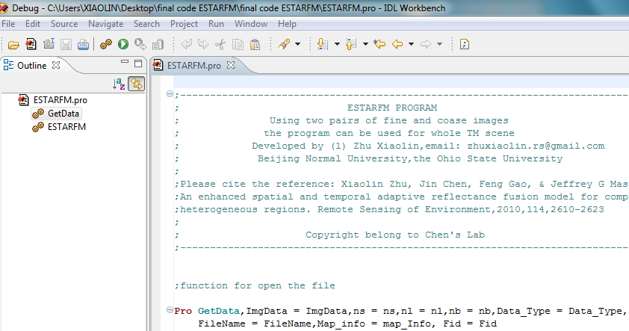
step1
Open IDL and the classic ENVI;
Open the code in IDL:

Slide 4
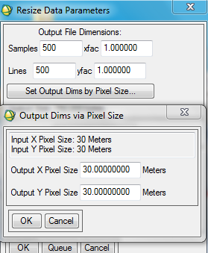
Step2
In ENVI: resample the MODIS images to the same spatial resolution as Landsat images, i.e. 30m;
Basic tools/resize data/resize data parameters
Change 500 to 30:
Resampling:
Bilinear is recommended to
reduced the effect of geo-referencing error

Slide 5
step3
Geo-rectified MODIS to Landsat:
Choose Landsat as reference, correct MODIS.
Envi/map-registration/ select GCPs: image to image

Slide 6
step4
Crop the MODIS images by Landsat, make sure they are with exactly same size:
Envi/File/save file as envi standard/import file-select MODIS image/spatial subset/file-select Landsat/ok
For the test data, we have done step2-step4!

Slide 7
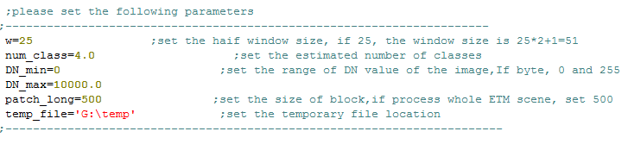
Step 5
Set the parameters: in IDL
Please follow the readme txt file to set the parameters

Slide 8
Step 6
Compile program:
IDL->run->compile ESTARFM.pro

Slide 9
Step 7
Run the code:
In the command line, type ESTARFM, then click “Enter”
The computing time dependents on size of image and the size of moving window.

